Slide 1

Cyber Security Engineering
CET324

Slide 2
Objectives
Introduce some of the elements of system security design and security engineering
In order to prepare for and attempt to prevent attacks we need to be aware of the security implications and issues in terms of systems security and information security
Discuss preventative measures

Slide 3
The Threat Matrix
Financial application crash
Internet worms
DofS attack
Privacy leak
Virus
Web services breach
Disgruntled employees
Business
Impact
Application security
Access management
failure
PDA/handhelds
earthquake
Wireless LANs
OS systems security
Information leak
E-mail content disclosure
Probability of Threat

Slide 4
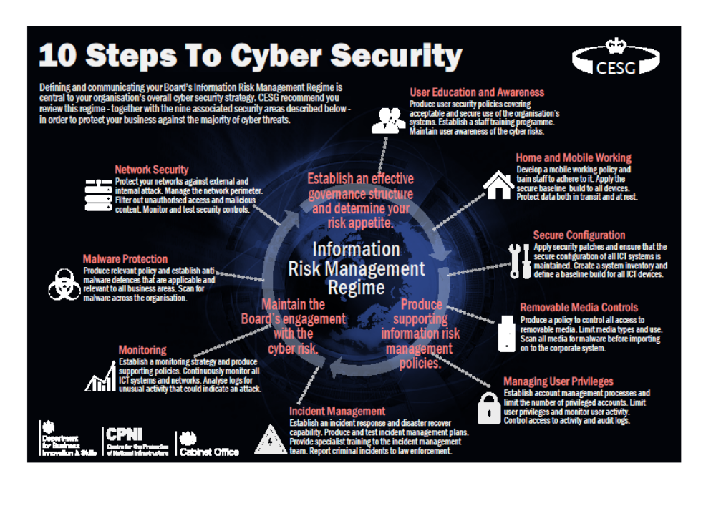

Slide 5
Rationale for Protection
Information and systems security is required in order to protect information
We need to know what the information is worth in order to determine the appropriate level of protection
Question - what value do you put on your personal information ?
Value can be defined or perceived
Your perception of value may different from an attackers
Value can change over time

Slide 6
Security Engineering
Security engineering is about building systems to remain dependable in the face of malice, error or mishance.
Focuses on tools, processes and methods required to design, implement and test complete systems
Require cross disciplinary expertise ranging from cryptography and computer security through to economics, psychology and law

Slide 7
Systems Assurance
Many systems have critical assurance requirements
  Control systems
  Finance systems
  Personal systems

Slide 8
Tasks to Do
Figure out what needs protecting and how to do it
  Identify your crown jewels, such as
    Patents, copyright, intellectual property, trademarks, trade secrets, brand management and identity, white papers, web and other advertising copy
  Intangible assets
    Contracts, customer relationships, goodwill
Need to ensure that the people who guard the system are properly motivated to do so

Slide 9
Security Engineering Analysis Framework
Policy
Incentives
Mechanism
Assurance

Slide 10
The Unknown
5 years ago it would have been difficult to predict that spam would by more than 80% of all e-mail traffic
Processing power continues to increase
  Moore’s Law processing power doubles every 18 month’s whilst the price halves !
  New materials, new techniques etc etc
Increasingly complex business systems
Cyber terrorism
People !
  Attackers have more time than defenders ?

Slide 11
Using Psychology in Attacks
Many attacks exploit psychology as much as technology – social engineering
“the human factor is truly security’s weakest link” – Mitnick (2002)
Attacks based on psychology
  Pretexting
  Phishing (combination of psychology and technology)
  Spear phishing
Passwords

Slide 12
Attacks on Passwords
Password entry is often poorly protected
  Interface design
  Eavesdropping (harvesting via WiFi)
Attacks on password storage
  One-way encryption
  Password cracking

Slide 13
Security Design Decisions
Where to focus security controls ?
  Data or operation or users
Where to place security controls ?
  Access control is the traditional centre of gravity of computer security
  Applications, services (middleware) operating systems or hardware
Complexity or assurance ?
  The more complex a system the more difficult it is to assure that system
Centralised or decentralised control ?
Blocking access to the layer below ?
  Stopping attacker bypassing protection mechanisms ?

Slide 14
Summary
Security design and security engineering are wide ranging subjects
Understanding security and how security might be breached will help us in computer forensics, in ethical hacking and in systems design

